Slide 1
The
The Cell Cycle
AEHBY Human Biology

Slide 2
Review
Enzyme molecules are assembled using a process that requires both transcription and translation. Compare these two processes. (8 marks)
Name one similarity and one difference between DNA and RNA. (6 marks)
If DNA only codes for amino acids (and therefore proteins), how does DNA control synthesis of carbs and lipids? (3 marks)

Slide 3
Learning Intentions
Mitosis forms part of the cell cycle producing new cells with the same genetic content.
Uncontrolled division of cells can result in the development of tumours/cancers
This Photo by Unknown Author is licensed under CC BY-SA-NC

Slide 4
Success criteria
Explain that cell division is necessary for growth and repair.
Explain that cancer involves uncontrolled cell division.
Recall and briefly describe the phases of the cell cycle.

Slide 5
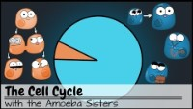

Slide 6
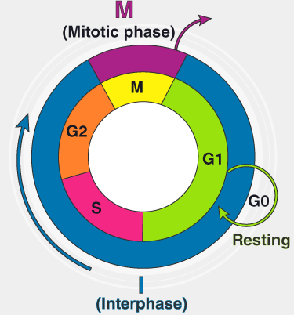
I phase (Interphase) -the cell undergoes normal function and prepares for division by undergoing both cell growth and DNA replication. It occupies around 95% time of the overall cycle.
The Cell Cycle
G1 phase (Gap 1) –the cell grows and undergoes normal function, incl mRNA synthesis for enzyme production
S phase (Synthesis) – DNA replication
G2­ phase (Gap 2) –Cell mass and number of organelles doubles. RNA, proteins, other macromolecules required for multiplication of cell organelles, spindle formation, and cell growth are produced as the cell prepares to go into the mitotic phase.

Slide 7

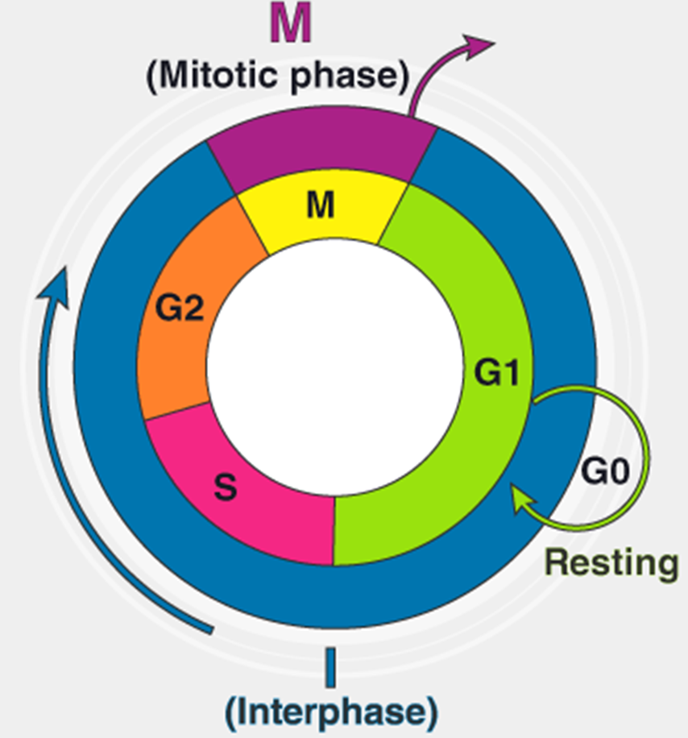

M phase (Mitosis)
The cell divides into two identical “daughter” cells.
Prophase
Metaphase
Anaphase
Telophase

Slide 8
G0 Phase (Resting)
After mitosis, cells may continue the cycle and re-enter G1 phase or enter the rest phase. Cells may stop dividing for days, years or the rest of the person’s life.

Slide 9


Slide 10
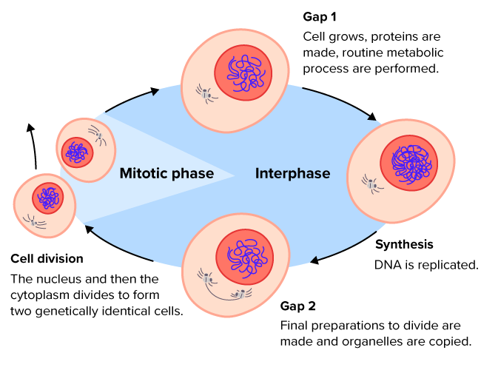

Slide 11
Success criteria
Explain that cell division is necessary for growth and repair.
Explain that cancer involves uncontrolled cell division.
Recall and briefly describe the phases of the cell cycle.

